Slide 1


A Community–Based System Dynamics Approach for Understanding Factors Affecting Mental Health and Health Seeking Behaviors in Beirut and Beqaa Regions of Lebanon
Aya Noubani, Karin Diaconu, Lilian Ghandour, Maria El Koussa, Giulia Loffreda, Shadi Saleh

Slide 2
RESEARCH TEAM
Aya Noubani ¹, Karin Diaconu ², Lilian Ghandour ³, Maria El Koussa ¹, Giulia Loffreda ², Shadi Saleh ¹
¹ Global Health Institute, American University of Beirut, P.O. BOX 11-0.236 Riad El Solh, 11072020 Beirut, Lebanon
² Institute for Global Health and Development, Queen Margaret University, Edinburgh, Scotland, EH21 6UU
³ Department of Epidemiology and Population Health, Faculty of Health Sciences, American University of Beirut, P.O. BOX 11-0.236 Riad El Solh, 11072020 Beirut, Lebanon

Slide 3
OUTLINE
Background
  Global burden of Mental Health Disorders
  Disparities in outcome and quality of care
  Burden of MH in Lebanon: Host and Syrian community
  Treatment Gaps
Significance and Objectives
Methods
Results
Conclusions and Recommendations

Slide 4
Background

Slide 5
GLOBAL BURDEN OF THE DISEASE
Mental illness, is defined as a group of disorders “characterized by some combination of abnormal thoughts, emotions, behaviours, and relationships with others”
7% of all global burden of disease as measured in DALYs and 19% of all years lived with disability were caused by mental and addictive disorders
Individuals with these disorders were found to face increased rates of morbidity from general medical conditions
Notes:
1- WHO, W. H. O. 2017a. Mental Health Fact Sheet [Online]. Available: https://www.who.int/en/news-room/fact-sheets/detail/mental-disorders [Accessed 10 July 2019
2- Rehm, J., & Shield, K. D. (2019). Global Burden of Disease and the Impact of Mental and Addictive Disorders. Curr Psychiatry Rep, 21(2), 10. doi:10.1007/s11920-019-0997-0
3-Kilbourne, A. M., Beck, K., Spaeth-Rublee, B., Ramanuj, P., O'Brien, R. W., Tomoyasu, N., & Pincus, H. A. (2018). Measuring and improving the quality of mental health care: a global perspective. World Psychiatry, 17(1), 30-38. doi:10.1002/wps.20482

Slide 6
DISPARITIES IN OUTCOME OF TREATMENT
A disproportionate number of affected individuals remain untreated - especially in low and middle-income countries (LMICs)
LMICs often have limited healthcare resources – with over 75% of mentally ill patients remaining untreated due to a shortage of mental health services

Slide 7
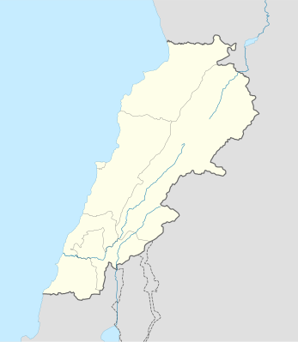
LEBANON: OVERVIEW
Mediterranean Sea
Lebanon is a LMIC in the Eastern end of the Mediterranean Sea
Fragile Health System
Highest number of refugees per capita in the world
Demographic shift had a considerable impact on the country’s health system, economy, employment and infrastructure
Lebanon
Syria
Occupied Palestine

Slide 8
Burden of Mental Health in Lebanon
There is lack of epidemiological data on the prevalence and burden of mental health disorders in the population of Lebanon
25.8% of a cohort of adults aged 18 or older at least one disorder and that 10.5% had experienced more than one disorder.
Anxiety was most prevalent (16.7%), followed by mood disorders (4.9%)
A minority of those with a mental health disorder received professional treatment.

Slide 9
Burden of Mental Health in Lebanon
Burden among Syrian Refugees
12% of the surveyed refugee households had experienced a physical or mental disability
3% of households reported one or more residents in need of mental care
Minorities have sought professional treatment
Difficulties in accessing services were due to the cost of treatment, consultation fees, and not knowing where to seek help

Slide 10
AIMS OF THE STUDY
Given the limited evidence on the underlying factors of mental health and the treatment gap
  Examine how Lebanese host and Syrian refugee communities perceive mental health and mental health problems
  Understand the dynamics of health seeking behaviours of both populations and the main issues faced by users in their health seeking and treatment journey
  Findings will inform Lebanon’s national mental health strategy and its aims

Slide 11
Methods

Slide 12
STUDY DESIGN
The study consisted of:
  1) Semi-structured interviews
  2) Four Group Model Building (GMB) workshops
Qualitative comparative study design
  Two different areas : Beirut vs Bekaa
  Two different populations: Syrians & Lebanese
  Gender sensitive groups
Ethical approval was obtained from the Institutional Review Boards at the American University of Beirut (AUB) and Queen Margaret University (QMU)

Slide 13
STUDY LOCATION
The study was conducted in two contrasting fragile contexts in Lebanon
  The highly urbanized Beirut area
  The rural areas of Beqaa
Beirut | Bekaa areas
Hosts 24% of Syrian Refugees | Hosts 36% of Syrian Refugees
Lowest poverty rates (16%) | Highest poverty rates (38%)
Has most of the health institutions | In need of major health institutional support

Slide 14
TARGET POPULATION
SAMPLING STRATEGY AND RECRUITMENT
Gender and age balanced
Have an interest in MH conditions
Caretakers of people with MH issues
Adults above 18
Non probability sampling
Purposive
Convenience
Recruitment
NGOs active in delivering MHPSS services
Primary health Care centers
UNHCR
Snowballing

Slide 15
Data Collection and Analysis: Semi Structured Interviews
Defining mental health and its causes
Society’s perception of MH
Help seeking behaviors and factors shaping these routes
Perceptions of seeking treatment from the health system and its barriers
Interviews were semi-structured and included questions on
Thematic Analysis was conducted
Two researchers read the transcripts and open coded a sample of transcripts
Developed a coding framework
Analyses were done in Dedoose
Inter-rater reliability testing was done (K=80%)

Slide 16
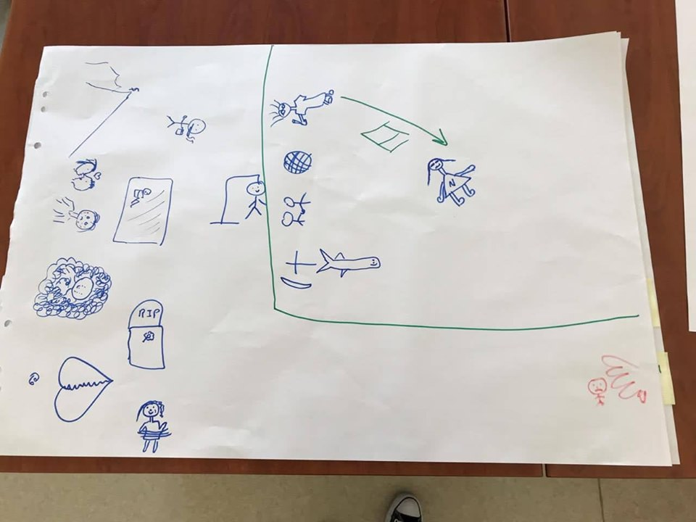
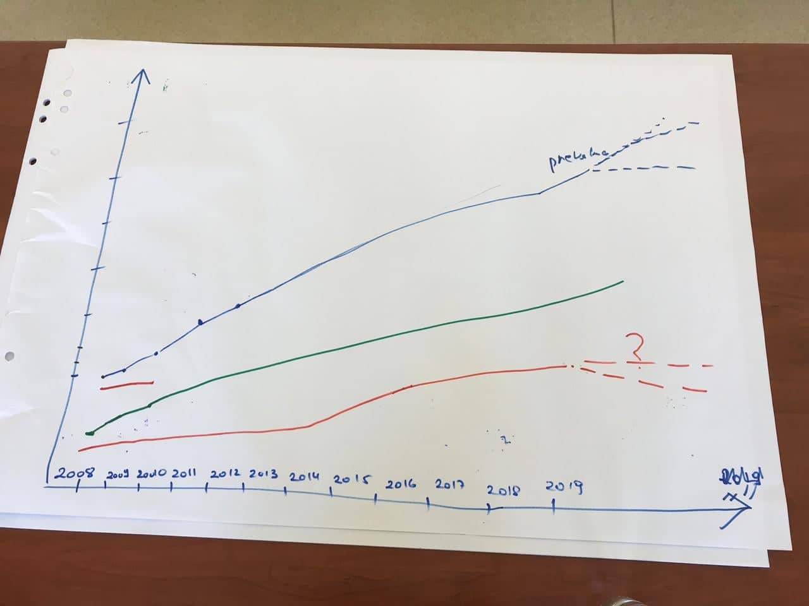
DATA COLLECTION AND ANALYSIS: GROUP MODEL BUILDING
1. Rich Pictures
2. Graphs and Trends

Slide 17
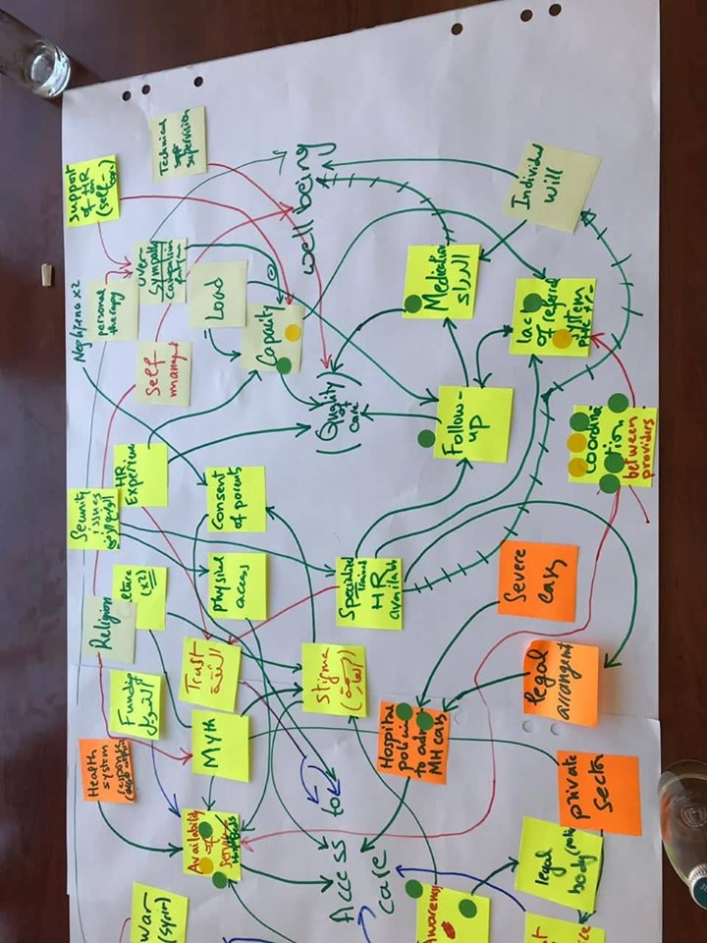
DATA COLLECTION AND ANALYSIS: GROUP MODEL BUILDING
Connections between the variables as described by participants in their initial concept models were translated into an electronic model using the bespoke software “VenSim”
models developed across the different workshops and groups were compared
Information from these models were further consolidated into one overarching causal loop diagram
3. Concept Model

Slide 18
RESULTS

Slide 19
Three thematic areas emerged from the data collected
Perceptions of mental health problems
Causes of mental health issues including the gender differences
Health seeking behaviours and practices to maintain wellbeing
1.
2.
3.

Slide 20
Perceptions of Mental Health Problems
Mental health problems are highly stigmatized, but inconsistencies are evident
Individuals with mental health issues are severely stigmatized: those affected are labeled ‘crazy’ and avoided because they cannot be taken seriously.
“They don’t view them positively. They would consider them crazy and as if they are less than human” A Syrian woman residing in Beirut
Most of the participants mentioned that they are against social stigma and discriminatory behavior
“It should be normal and without pressure. Society should reduce the person’s burden.” A Syrian women living in Beqaa
Many discussed the importance of seeking help from a therapist and normalized this practice.

Slide 21
When discussing the onset of mental health issues, participants identified diverse drivers and risk factors
Causes of Mental Health Issues
  Long term effects of exposure to war and violence (Blue Zone)
  Integration challenges resulting from the political and social effects of war (orange Zone)
  Socioeconomic constraints (Green Zone)
  Gendered expectations driving onset of mental health issues (yellow zone)

Slide 22
Causes of Mental Health Issues
Causal Loop Diagram

Slide 23
Long term effects of exposure to war and violence (Blue Zone)
Trauma experienced due to war and conflict
Trauma due to violence within the family

Slide 24
Integration challenges resulting from the political and social effects of war (Orange Zone)
Political system vulnerable to corruption facing major challenges in governance
The influx of Syrian refugees to Lebanon aggravating challenges at the governance and economy levels.
Syrian refugees talked about their suffering from discrimination

Slide 25
  Socioeconomic constraints (Green Zone)
Unemployment and expensive livelihoods
Job competitions between Syrians and Lebanese
Social inequality

Slide 26
Gendered expectations driving onset of mental health issues
Financial obstacles were major drivers of stress in men
Social inequality and the patriarchal social system were major challenges for women
Tasks of child rearing and household responsibilities were overwhelming and stressful for women
Notes:
Men in Blue
Women in Violet

Slide 27
Health seeking behaviors and practices to maintain wellbeing
Participants discussed three main areas around health seeking behaviors
Factors affecting the rate of health seeking
Diverse routes for health seeking
Drivers and barriers for seeking support from the health system

Slide 28
Health seeking behaviors and practices to maintain wellbeing
Stigma and concerns about confidentiality were main factors shaping the rate of health seeking

Slide 29
Health seeking behaviors and practices to maintain wellbeing
Social connectedness determines the health seeking behavior

Slide 30
Health seeking behaviors and practices to maintain wellbeing
Gender differences were identified around coping mechanisms
Notes:
Family and friends
Coping mechanisms
Gender differences

Slide 31
Health seeking from the Health System
Participants identified social stigma and mistrust in the quality of the service as major issues faced to accessing the health system

Slide 32
Health seeking behaviors and practices to maintain wellbeing

Slide 33
Points of fragility
At household level
  Availability of finances
  Unemployment
At community level
  Political instability in Lebanon
  Governance challenges and corruption contributing to poverty
At the individual level
  Women focused on family issues and raising children
  Men focused on the issues of employment and socioeconomic situation in the country

Slide 34
Intervention strategies discussed by participants
Both Communities
Creating job opportunities
Increasing salaries
Lebanese
Raising awareness to fight stigma
Reducing the cost of MH treatment
Improving financial status
Syrians
Enacting educational strategies to fight discrimination and reduce social tension

Slide 35
Limitations
Findings that emerged are formative, but cannot be generalized
Researcher bias: The researcher perspective may influence the synthesis of the causal loop diagrams
Selection and information bias: Most of our participants who attended the workshop were from lower socioeconomic groups

Slide 36
Conclusions and Recommendations

Slide 37
Conclusions
This first qualitative comparative study using systems dynamics to elicit and interrelate a range of factors contributing to mental health issues and health seeking behaviors as perceived by community members in Lebanon
The causal loop diagram acts as framework to gain insights into the locally and contextually specific factors that influence mental health issues
Long-term effects of exposure to wars, political and social effects of conflicts and financial constraints are factors prompting the onset of mental health and psychosocial stressors
Gender and integration related challenges between communities also affect condition onset and associated care seeking.
Pathways for health seeking are shaped by trust, the advice and support of loved ones, and the need to ensure confidentiality of affected individuals

Slide 38
Recommendations
Future research is needed to assess generalizability to other settings and populations in Lebanon
Building on the core structure of the synthesized causal loop model, further research hypotheses on topics related to gender challenges as well as integration problems is needed.
The model identified leverage points that may take the form of a program or intervention that strengthen the strategy of the National Mental Health Program (NMHP)
The findings identified the need for gender- and integration-sensitive mental health and psychosocial support potential strategies primarily focused on condition prevention and awareness raising in order to strengthen health seeking behavior.

Slide 39
Thank You

