Slide 2
Master of Occupational Therapy Programme

Slide 3
Background and Rationale for Change
The changing Health and Social Care landscape
Internally, the QMU portfolio review
Building a QMU community of occupational therapy programmes – educators and learners
An increasingly competitive HE market
Notes:
Changing H&SC landscape
Means an extension of the roles & skills for AHPs and a masters level degree will enable to prepare graduates to be able to work within this changing landscape.
The proposed programme will prepare graduates for entering the pathway towards advanced practice.
Internally, QMU undertook a portfolio review. The outcomes of this review were
A move to improve the efficiency of programme delivery (preventing duplication across pre-reg provision)
A move to increase the number of PG students
Beyond the portfolio review, we saw this as a really positive opportunity to create an integrated community of occupational therapy educators and learners
Local competitors already providing M level OT programme
So in rethinking our approach towards reshaping our pre-reg provision, we were guided by the institutional vision and mission, as well as our divisional values, which relate very well to our philosophical standpoint….:
{SLIDE}

Slide 4
Programme Philosophy
The centrality of occupation in the lives of individuals and communities
Our responsibility to recognise the occupational barriers and injustices affecting participation
Our responsibility to recognise and anticipate the needs of individuals, groups, communities and societies (WFOT 2016)
Putting sustainability at the core of education
Notes:
Underpinning our programme philosophy is the belief that health and wellbeing can be sustained and enhanced when people are engaged in meaningful and valued occupation.
Two other factors aligned with World Federation standards are around recognising occupational barriers and injustices, and anticipating the occupational needs of individuals groups communities.
Lastly, sustainability: education is such an important for change, particularly when it comes to sustainability, so sustainable practice both within and outside of the university as well as recognising the links between the concepts of sustainability and occupation
{SLIDE}

Slide 5
Programme Aims
Produce graduates who are autonomous, critical thinking lifelong learners
Produce graduates who meet the HCPC standards of proficiency for safe and effective occupational therapy practice
Instil a strong professional identity
Instil the value of collaborative, person / community centred practice
Notes:
We aim to produce graduates who are autonomous, critical thinkers, lifelong learners.
The next slide outlines a few more outcomes for our graduates.
Of course, we aim for our graduates to be competent occupational therapists, so our graduates meet HCPC SOPs.
We aim to instil a really strong professional identity, so our graduates are able to recognise and articulate unique contribution of occupation to the health and wellbeing of individuals, families groups and communities.
We aim to produce graduates who value collaborative, person / community centred practice.
{SLIDE}

Slide 6
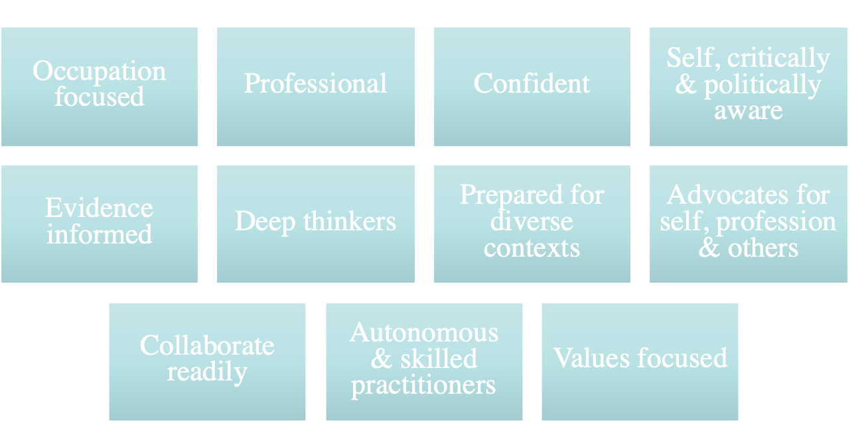
Graduate Outcomes
Notes:
So this slide summarises who graduates will be, and how they will practice:
Occupation focused,
Professional
Confident
Self aware
Politically aware
Critical thinking
Evidence informed
Prepared for practice in diverse contexts
Strong collaborator yet autonomous and skills practitioner
Very much focused on values
And able to advocate well for themselves, others and the occupational therapy profession.
{Slide}

Slide 7
Routes into the Profession
Two routes into occupational therapy practice:
  A four-year route: completion of BSc (Hons) or MOccTher
  An accelerated route (two years): completion of MSc or PG Dip
Learners will be integrated as much as possible, building a strong community of occupational therapy students at QMU
Notes:
This new programme offers two routes into occupational therapy practice:
Learners integrates as much as possible, as can be seen in the next slide which outlines the structure
{slide}

Slide 8
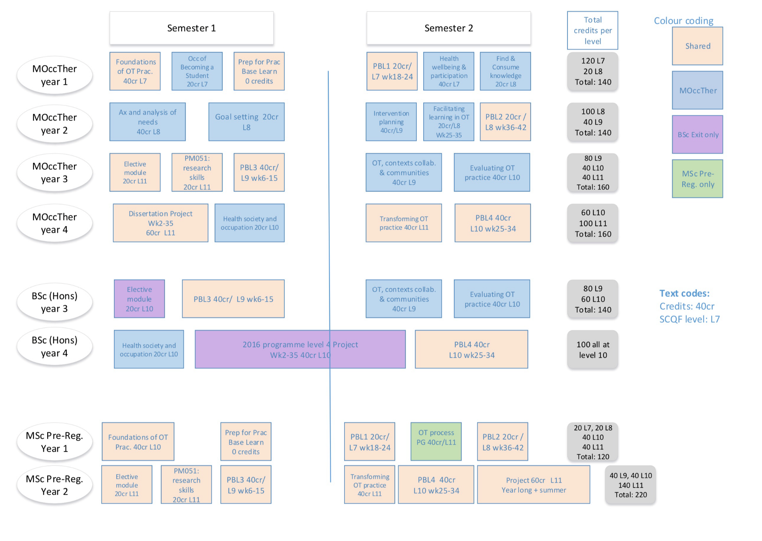
Structure
Notes:
Programme design:
In the four year programmes, in every level there is a module set at a higher SCQF level, building the learners’ skills and knowledge in preparation for the next year of studies
Note we have gone for maximal integration of modules
Within reason, there are the obvious constraints to full integration given the pace of learning and the requirements of the BSc (Hons) route
Overall number of credits per award:
BSc (Hons): 520 SCQF 7-10
MOccTher: 600 SCQF 7-11
MSc: 340 SCQF 10-11 (with practice placement modules offered at the same level as the undergraduate route).
Note that learners in all routes will be on practice based learning experiences at the same time.

Slide 9
Anticipated Numbers
The numbers will reflect market demands
n=35 (+2DE) UG and n=40 PG entrants making any given cohort maximum of 77 learners
The overall head count in any given academic session will be 226, taking into account 4 levels of UG learners, and 2 levels of PG learners
These figures will be phased in as we transition between the old and the new programmes
Notes:
Transition arrangement are set out in section 10 of Document B

Slide 10
Entry and Exit Points
Learners can enter the programme at either level 1 (all routes) or level 2 (MOccTher and BSc (Hons) only)
Non-practice awards are available upon completion of each level as per standard for the sector
We are offering four practice awards:
  BSc (Hons) in Occupational Therapy
  Master of Occupational Therapy (new) (pre-registration)
  PG Diploma in Occupational Therapy (pre-registration)
  MSc in Occupational Therapy (pre-registration)
Notes:
Entry:
Learners can enter the programme at either level 1:
Or at level 2 for UG entrants only – this entry point is applicable only
to those who have completed the HNC in OT Support from Glasgow Clyde College.
Outlined in section 8 of document B.

Slide 11
Our USP
The only university in Scotland to offer all levels of occupational therapy education
Unique opportunities to articulate into post-registration MSc and PhD programmes
A programme centred around occupation, underpinned by ethos of person centredness and strongly aligned to Occupational Therapy Pillars of Practice
Occupational Therapy education that is prospective looking and anchored in the real world.
Strong partnerships with diverse stakeholder groups: experts by experience, 3rd sector organisations, practice and research settings
Strong links both within the local community and internationally
High graduate employment rates
Notes:
So what makes QMU an attractive place for learners?
We are the only university in Scotland to offer all levels of OT education
We have a strong national and international reputation for our programmes, also recognised in the recent rankings of the Complete University Guide
Our learners can articulate into post reg masters and PhDs at QMU, because of the success of our suite of programmes
Our programme is centred around occupation and strongly aligned to RCOT Occupational Therapy Pillars of Practice, helping make the transition to practice and lifelong learning seamless
Our approach to OT education is prospective looking and anchored in the real world.
Strong partnerships with diverse stakeholder groups: Our partnerships mean that we engage at a variety of levels: from engaging with people with lived experience across the programme to creating innovating placements models as well as partnerships with research centres and groups, meaning that our curriculum remains evidence based.
Strong links both within the local community as well as internationally e.g. seen through some of our modules
And lastly, we are proud of our high graduate employment rates both within the UK and internationally

